Slide 1
Compassion
Part of the DNA of Care Programme

Slide 2
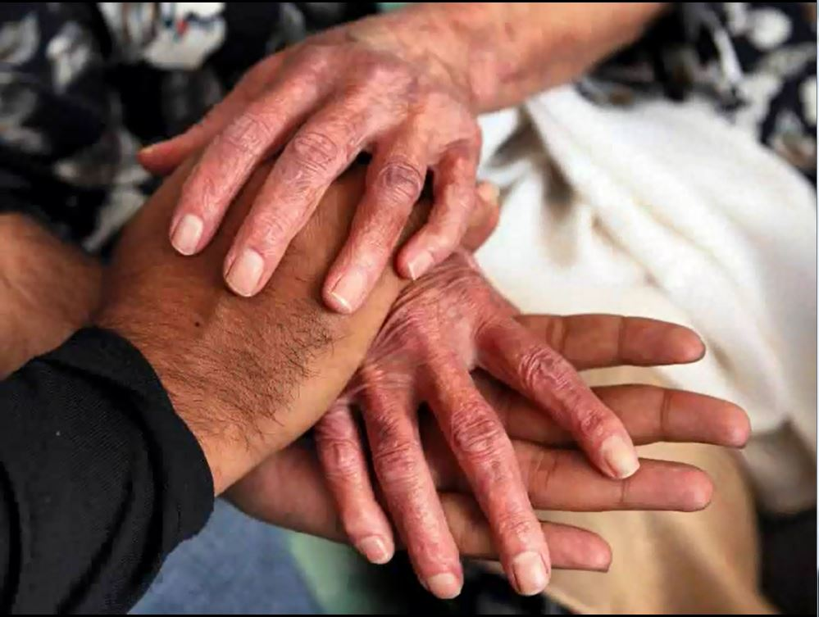
Compassion
‘The whole idea of compassion is based on a keen awareness of the interdependence of all these living beings, which are all part of one another, and all involved in one another.’
Thomas Merton
Photo © Henri Rahman

Slide 3
Compassion, kindness and community
Penny Campling 2013

Slide 4
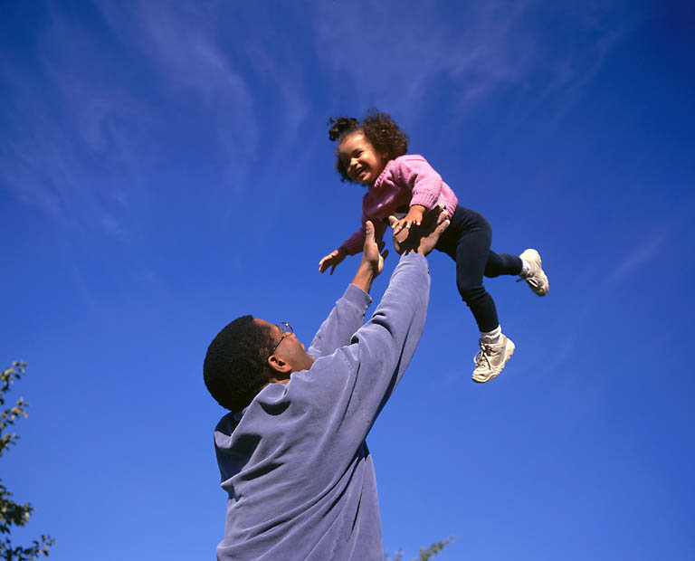
Kindness and kinship
Cynd (Old English) = nature, family, lineage – kin
‘Kindness implies the recognition of being of the same nature as others – being of a kind – in kinship.’

Slide 5
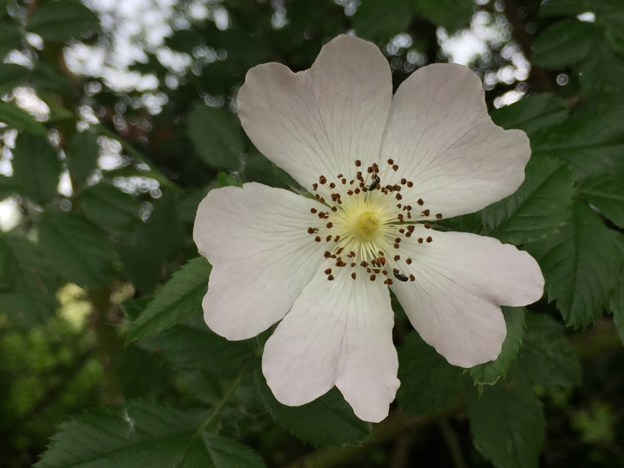
Compassion fatigue
‘It is not enough simply to aim to reduce staff stress levels.
We should be promoting the idea that humans can flourish in the workplace.’ Michael West, 2016
Photo © Pip Hardy

Slide 6
Caring for those who care
Compassion is ‘experienced by staff as a result of the thoughtful, caring, and empathetic actions of others.’
NHS England Commissioning for compassion guide
‘We must show the same care and consideration to ourselves and our colleagues as we do to those we serve.’
Leading change, adding value

Slide 7
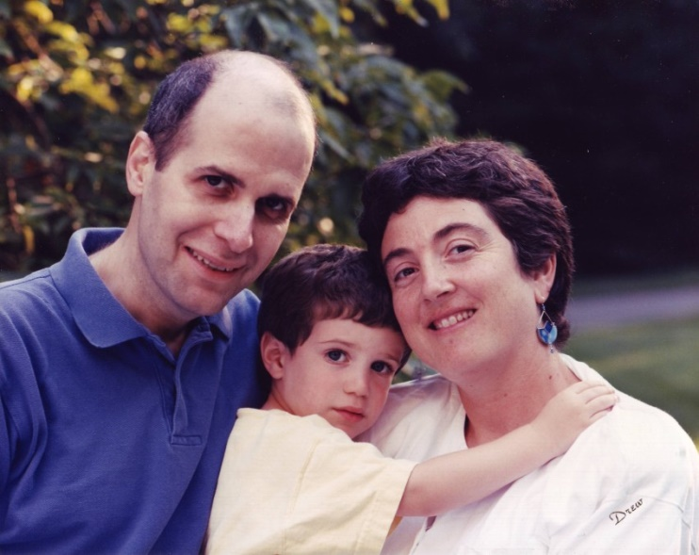
Compassion in the workplace
‘I cannot emphasise enough how meaningful it was to me when care-givers revealed something about themselves that made a personal connection to my plight. The rule books, I’m sure, frown on such intimate engagement between care-giver and patient. But maybe it’s time to rewrite them.’
Kenneth Schwartz
Photo courtesy The Schwartz Center

Slide 8
The DNA of Care
‘The intertwined relationship between patient care and staff well-being has been likened to the double helix. And so the stories we tell each other are like the DNA of care, transmitting information and shaping cultures, offering learning opportunities and, sometimes, healing.’
Pip Hardy and Tony Sumner, 2016

Slide 9
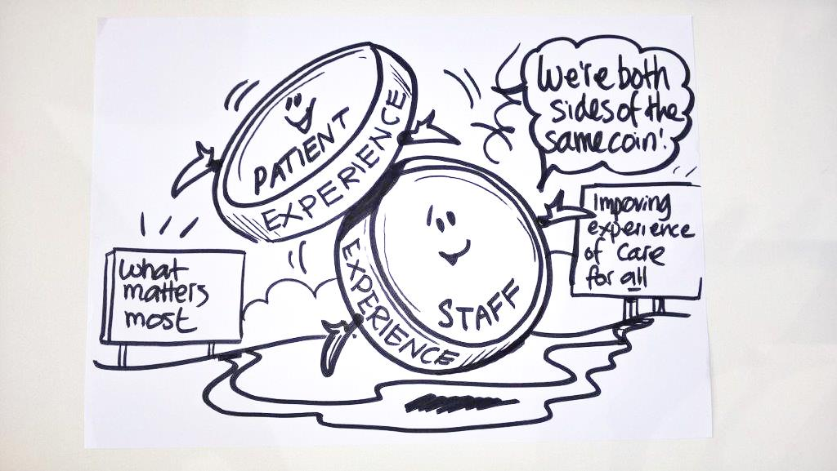
Two sides of the same coin
Staff experience drives patient experience.
‘Focusing on this relationship could be the most important move for the healthcare system to make.’
Karen Deeny, 2017

Slide 10
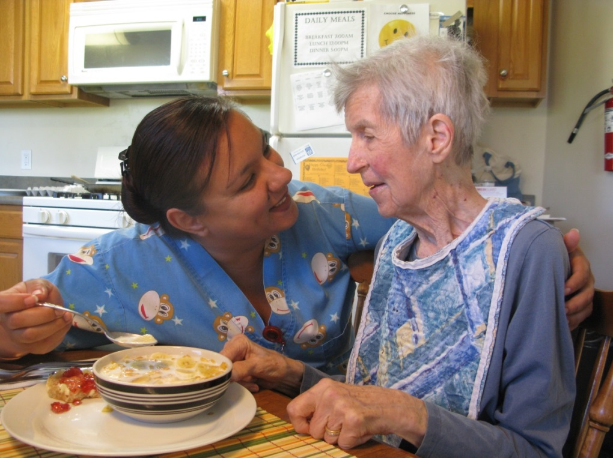
Compassion for everyone
‘Both staff and patients need care, compassion and respect.’
Professor Michael West 2014
Photo © Pip Hardy

Slide 11
DNA of Care stories of compassion
Stay
Impermanence
Tears
Critical care
Making a difference
The wooden soldier
You can do this!
Touch
Time to care
Baby steps

Slide 12
Stay
www.patientvoices.org.uk/flv/1019pv384s.htm Rachel Scanlan 2016

Slide 13
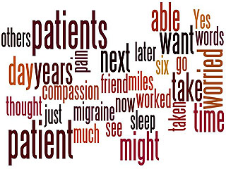
Impermanence
www.patientvoices.org.uk/flv/1028pv384s.htm Natasha Curran 2016

Slide 14
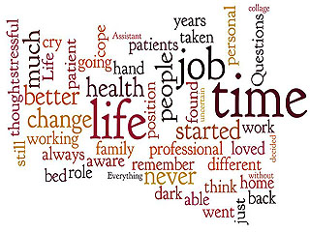
Tears
www.patientvoices.org.uk/flv/1008pv384s.htm David Charlton 2016

Slide 15
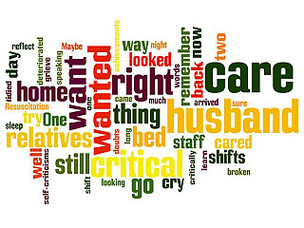
Critical care
www.patientvoices.org.uk/flv/1011pv384s.htm Louise Samuel 2016

Slide 16
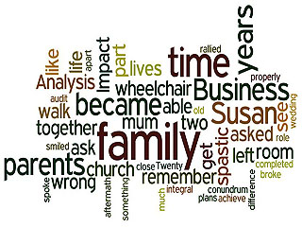
Making a difference?
www.patientvoices.org.uk/flv/1012pv384s.htm Denise Jones 2016

Slide 17
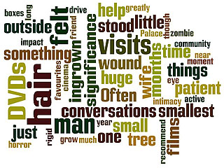
The wooden soldier
www.patientvoices.org.uk/flv/1015pv384s.htm Steven Yull 2016

Slide 18
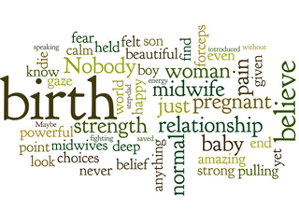
You can do this!
www.patientvoices.org.uk/flv/0996pv384s.htm Elaine Brand 2016

Slide 19
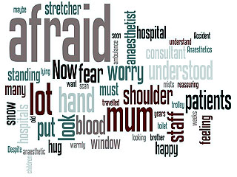
Touch
www.patientvoices.org.uk/flv/1006pv384s.htm Damon Kamming 2016

Slide 20
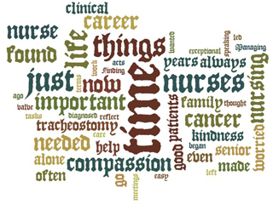
Time to care…
www.patientvoices.org.uk/flv/0998pv384s.htm Jacqueline Richardson 2016

Slide 21
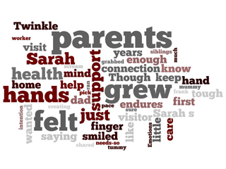
Baby steps
www.patientvoices.org.uk/flv/0997pv384s.htm Ann Pettit2016

Slide 22
Questions for reflection
What do you understand by compassion?
How do you think these stories illustrate compassionate care?
In what ways (if at all) do these stories change your ideas about compassion?
In what ways do you show compassion for yourself? For your colleagues?
How far do you think compassionate care for patients relies on compassionate care for staff?

Slide 23
Questions for reflection
What three things does xx story focus your attention on, in terms of what you (or we) should do next?
Having seen xx story, what is the one thing you feel compelled to do immediately?
How do the DNA of Care stories capture the importance of asking all staff ‘what matters to you?’?

Slide 24
Questions for reflection
Which elements of compassion do the stories you have seen support the development of a compassionate culture?
How do the stories you have seen highlight the risks of not developing compassionate cultures?
How can the DNA of Care stories help us to ‘rewrite the rule books’, to make more personal connections and have the courage to embrace vulnerability?

